Slide 1
ECE 471/571 – Lecture 10
Nonparametric Density Estimation – Parzen Windows
09/24/14

Slide 2
Different Approaches - More Detail
Pattern Classification
Statistical Approach
Syntactic Approach
Supervised
Unsupervised
Basic concepts:
Baysian decision rule
(MPP, LR, Discri.)
Basic concepts:
Distance
Agglomerative method
Parametric learning (ML, BL)
k-means
Non-Parametric learning (kNN)
Winner-take-all
NN (Perceptron, BP)
Kohonen maps
Dimensionality Reduction
Fisher’s linear discriminant
K-L transform (PCA)
Performance Evaluation
ROC curve
TP, TN, FN, FP
Stochastic Methods
local optimization (GD)
global optimization (SA, GA)
ECE471/571, Hairong Qi

Slide 3
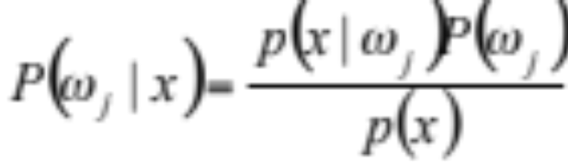
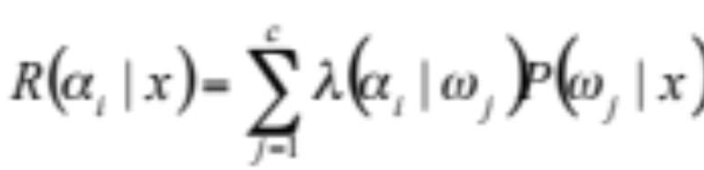

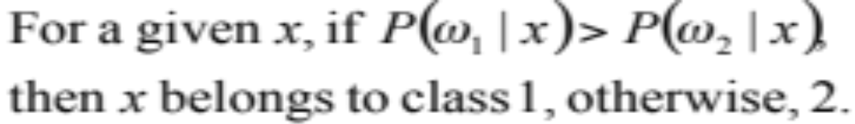
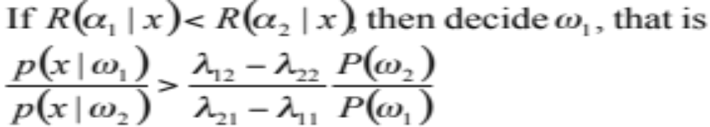
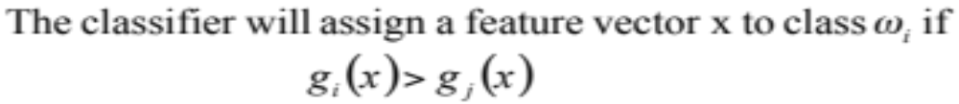
Bayes Decision Rule (Recap)
Maximum
Posterior
Probability
Likelihood
Ratio
Discriminant
Function
Three cases
Estimate Gaussian, Two-modal Gaussian
Dimensionality reduction
Performance evaluation and ROC curve

Slide 4

Motivation
Estimate the density functions without the assumption that the pdf has a particular form

Slide 5
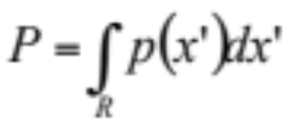

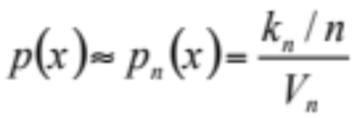

*Start from Histogram
In order to generate a reasonable representation for the density, we’d like to first “smooth” the data over cells
The probability that a vector x will fall into a region R is
If p(x) does not vary significantly within R, then
  V is the volume enclosed by R
For a training set of n samples, k of them fall into the hypervolume V, we can then estimate p(x) by

Slide 6
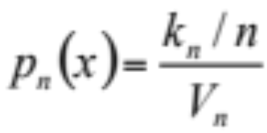
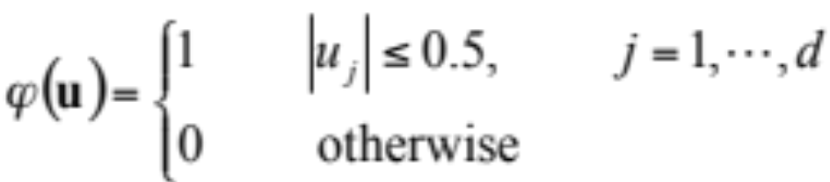
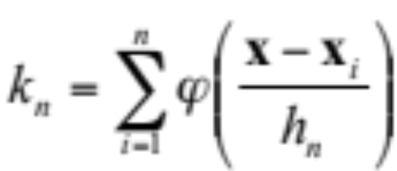
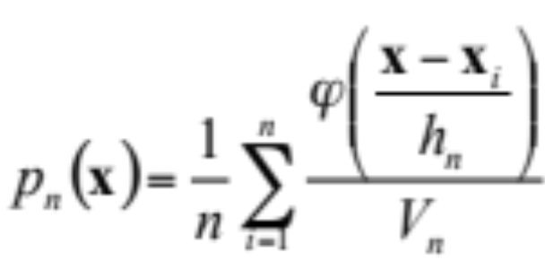
*Parzen Windows
The density estimation at x is calculated by counting the number of samples fall within a hypercube of volume V_{n} centered at x
Let R be a d-dimensional hypercube, whose edges are h_{n} units long. Its volume is then V_{n}=h_{n}^{d}
The window function
Therefore

Slide 7
*Problem
Hypercube – why should a point just inside the hypercube contribute the same as a point very near to x, while a point just outside the hypercube contributes nothing?
Use a continuous window function

Slide 8
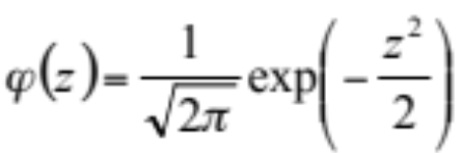
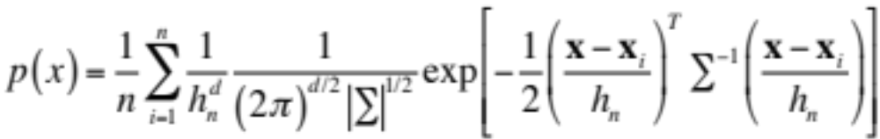
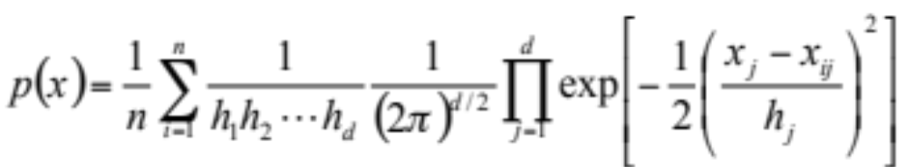
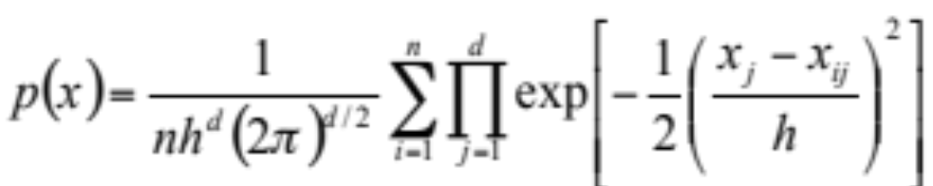
*Continuous Window Function
Univariate
Multi-variate
Making Σ an identity matrix
h_{j} reflects the variance (spread) of the smoothing kernel (window function) in the jth coordinate direction. If we assume the spread is equal in all directions

Slide 9
*Comparison

Slide 10
*Another Problem
How to choose h?
A large h will result in a great deal of smoothing and loss of resolution
A very small h will tend to degenerate the estimator into a collection of n sharp peaks, each centered at a sampling point
Solution: h should depend on the number of samples. If only a few samples are available, we require a large h and considerable smoothing, whereas if many points are available, we can use a smaller h without the danger of degenerating into separate peaks.

Slide 11
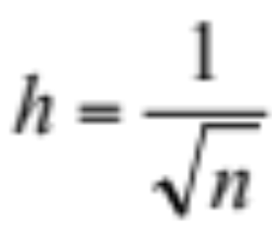
*The Choice of h
We make h a function of n

Slide 12
*Problem with Parzen Windows
Discontinuous window function -> Gaussian
The choice of h
Still another one: fixed volume

